Slide 2


Aligning ALM Tools and Bringing Excellence to ALM Ecosystems
Brett Taylor CEO
Doug Bass SVP Engineering
Notes:
Today I am going to show you how to integrate your ALM systems to make your life easier and better serve your users. Netter integration means better collaboration and more productivity. And – it makes your life easier!

Slide 3

About Go2Group
Founded in 2002
Leading industry experts in ALM (application lifecycle management)
Global, experienced team
Offices in US, India, Japan, China, Europe
35 full-time employees
GSA Listed
Notes:
First, a little about Go2Group. We’re experts in all flavors of application lifecycle management (ALM). Founded in 2002, we have offices and customers worldwide. For government buyers, we’re on the GSA schedule.

Slide 4







Expert in ALM
Expert in ALM tools from HP, Atlassian, IBM, Perforce, Salesforce, TFS, and SugarCRM
HP Gold Business Partner
The world’s largest reseller of Atlassian development tools
Enterprise Platinum Atlassian Expert
Notes:
We provide expert services for all the major ALM providers and are certified experts.

Slide 5













Experienced in ALM
Hundreds of software productivity installations since 2002
Hundreds of active clients
Operational in 66+ countries
| Go2Group .com
Notes:
We’ve implemented software productivity systems for hundreds of clients in all industries, worldwide.

Slide 6




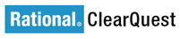



The Problem
Multiple workgroups — worldwide!
Multiple ALM systems
Multiple data sources
Notes:
Most systems start simple. But different teams have different needs. Are your workgroups and departments all using one ALM system? Probably not. Different teams in test, sales and support, R&D, and elsewhere have adopted different systems.

Slide 7
The Problem: Siloed Data
Notes:
Because ALM systems don't talk to each other or share data, users can’t see or change items in systems they don't use. Some users are forced to access multiple systems over and over again. Users will copy and paste items between systems.

Slide 8

ConnectALL Tears Down Walls
TM
Notes:
ConnectALL removes the barriers by synchronizing data between systems. Each user sees all the tasks and projects in the system that’s best for that user! ConnectALL connects them all!

Slide 9
Go2Group: ConnectALL
Many Systems
Many Processes
Many Problems
One Solution
Federation
Collaboration
Overall Process View
Notes:
By unifying your systems, your teams become more productive. And it’s easy! Without replacing ANYthing, your systems are federated, your teams are collaborating, and your processes become one!

Slide 10
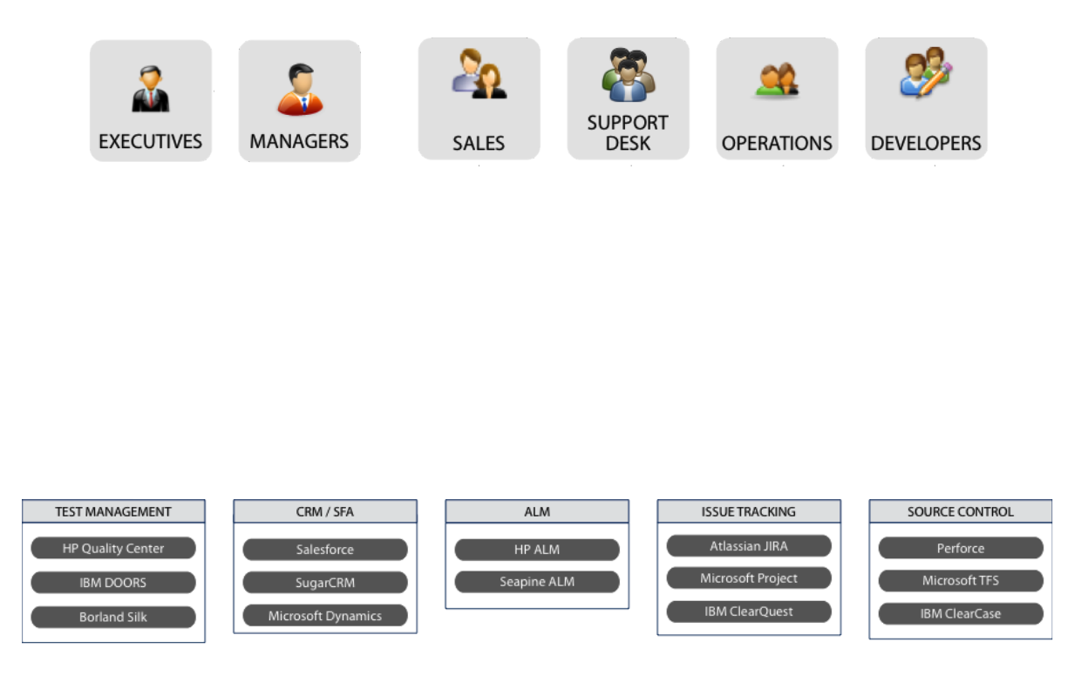
ConnectALL
Connects teams, systems, processes
True knowledge sharing
Notes:
With ConnectALL, the walls come down! Projects, tasks, and results in one system are visible to everyone who needs to see them.

Slide 11







Use the tool that best fits your business
Manage multiple tools customizations with high scalability
Secure your data all the time with built-in permissions
Plan to automate data sync with external systems
Notify and optimize team’s response for faster delivery
Notes:
1. Everyone uses the systems they know
2. Visual interface. Easy to configure. Easy to administer
3. Well defined permissions. Built-in User management
4. Flexible scheduling option. View all schedules visually. Scheduling options are Minutes, Hourly, Daily, Weekly, Monthly etc
5. Alarms - ALM outage, Sync Failures, DB outage. Comprehensive dashboard - Real-time activity logs, Sync statistics, failures

Slide 12
Reporting Options
ConnectALL reports sync data over period of time. It is easy to produce the trend by ALM tool / Project / Entity Type.
Examples:
Records of requirements created/updated in a particular month
Number of Defects created/updated in a particular month
Number of last 10 sync failures
Trend of Jira 6 – ALM 12 sync over a week
Total number of conflicts occurred

Slide 13

Connectors
ALM/Issues Type | Bug | Tasks | Requirements | Test Case | Test Run
JIRA
HP QC
TFS
Seapine
Doors
ClearQuest
Rally

Slide 14
Your ALM Process
DOORS
Quality Center
Requirements
Test Cases
Sprints/ Stories
Defects
JIRA
© 2012 The Go To Group, Inc.

Slide 15
ALM Process Between QC to QC
Requirements
Defects
Test Cases
Sprints/Stories
In-House QC
Off-Shore QC
© 2012 The Go To Group, Inc.

Slide 16
Simple ALM Process
Requirements
Defects
Test Cases
Sprints/ Stories
In-House JIRA
Off-Shore JIRA
© 2012 The Go To Group, Inc.

Slide 17
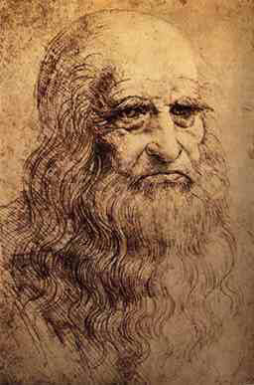
Complexity
“Simplicity is the ultimate sophistication”
— Leonardo daVinci
Notes:
At Go2Group, we have tons of experience with complex systems — and they make people crazy!
Well, it makes us crazy, too! That’s why we developed ConnectALL, which is all about making complex ALM systems work together. With ConnectALL, your software teams become more productive and more collaborative. And it’s simple for you, simple for your users.

Slide 18
Questions?
Doug Bass dbass@go2group.com
Brett Taylor btaylor@go2group.com
Notes:
Thank you! If you have questions, please contact us.

Slide 19
Thank you

